Slide 1
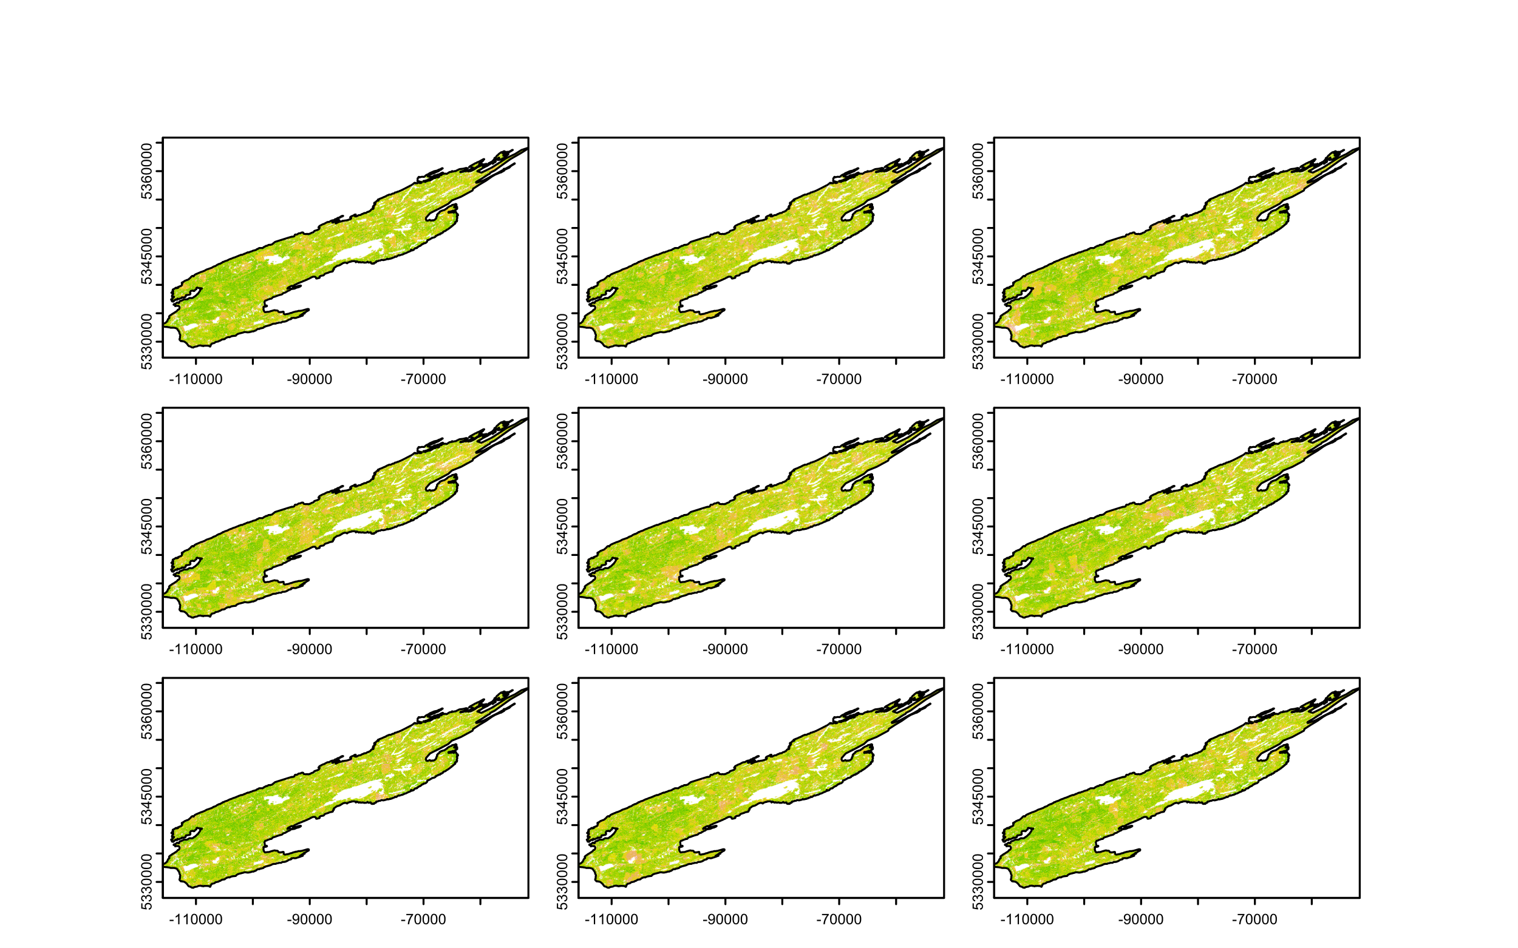
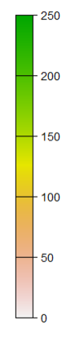
Climate
Low
Hot/Dry
Warm
Hot/Wet
Biomass
density
(Mg ha⁻¹)
Predation rate
Medium
High

